Slide 1
Using the PBCore Cataloging Tool

Slide 3
PBCore Cataloging Tool: Tasks
Set a folder for records
Create an Asset
Create an Instantiation
Add an Element
Add an Attribute
Use Controlled Vocabs
Save Records
Search for Records
Use Advanced Search
Batch Edit Records
Create a Spreadsheet
Open from Spreadsheet

Slide 4
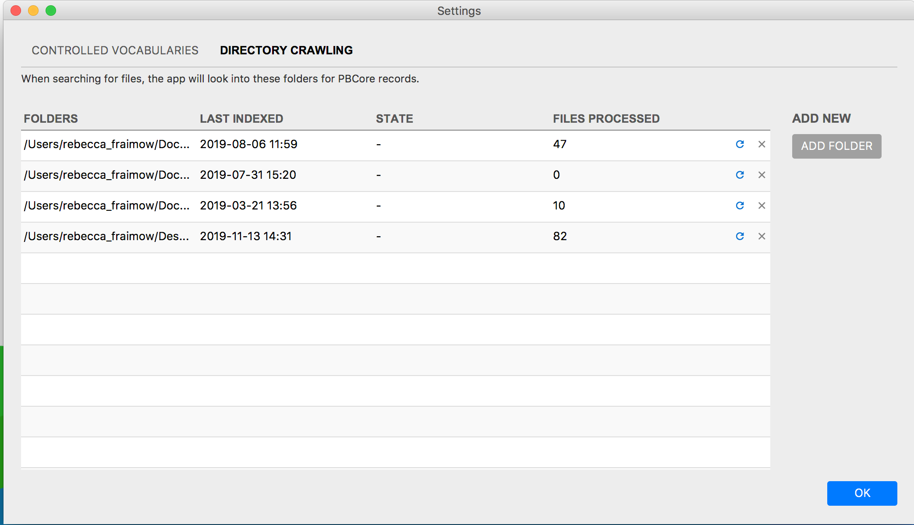
Set a folder for records

Slide 5
Create an Asset

Slide 6
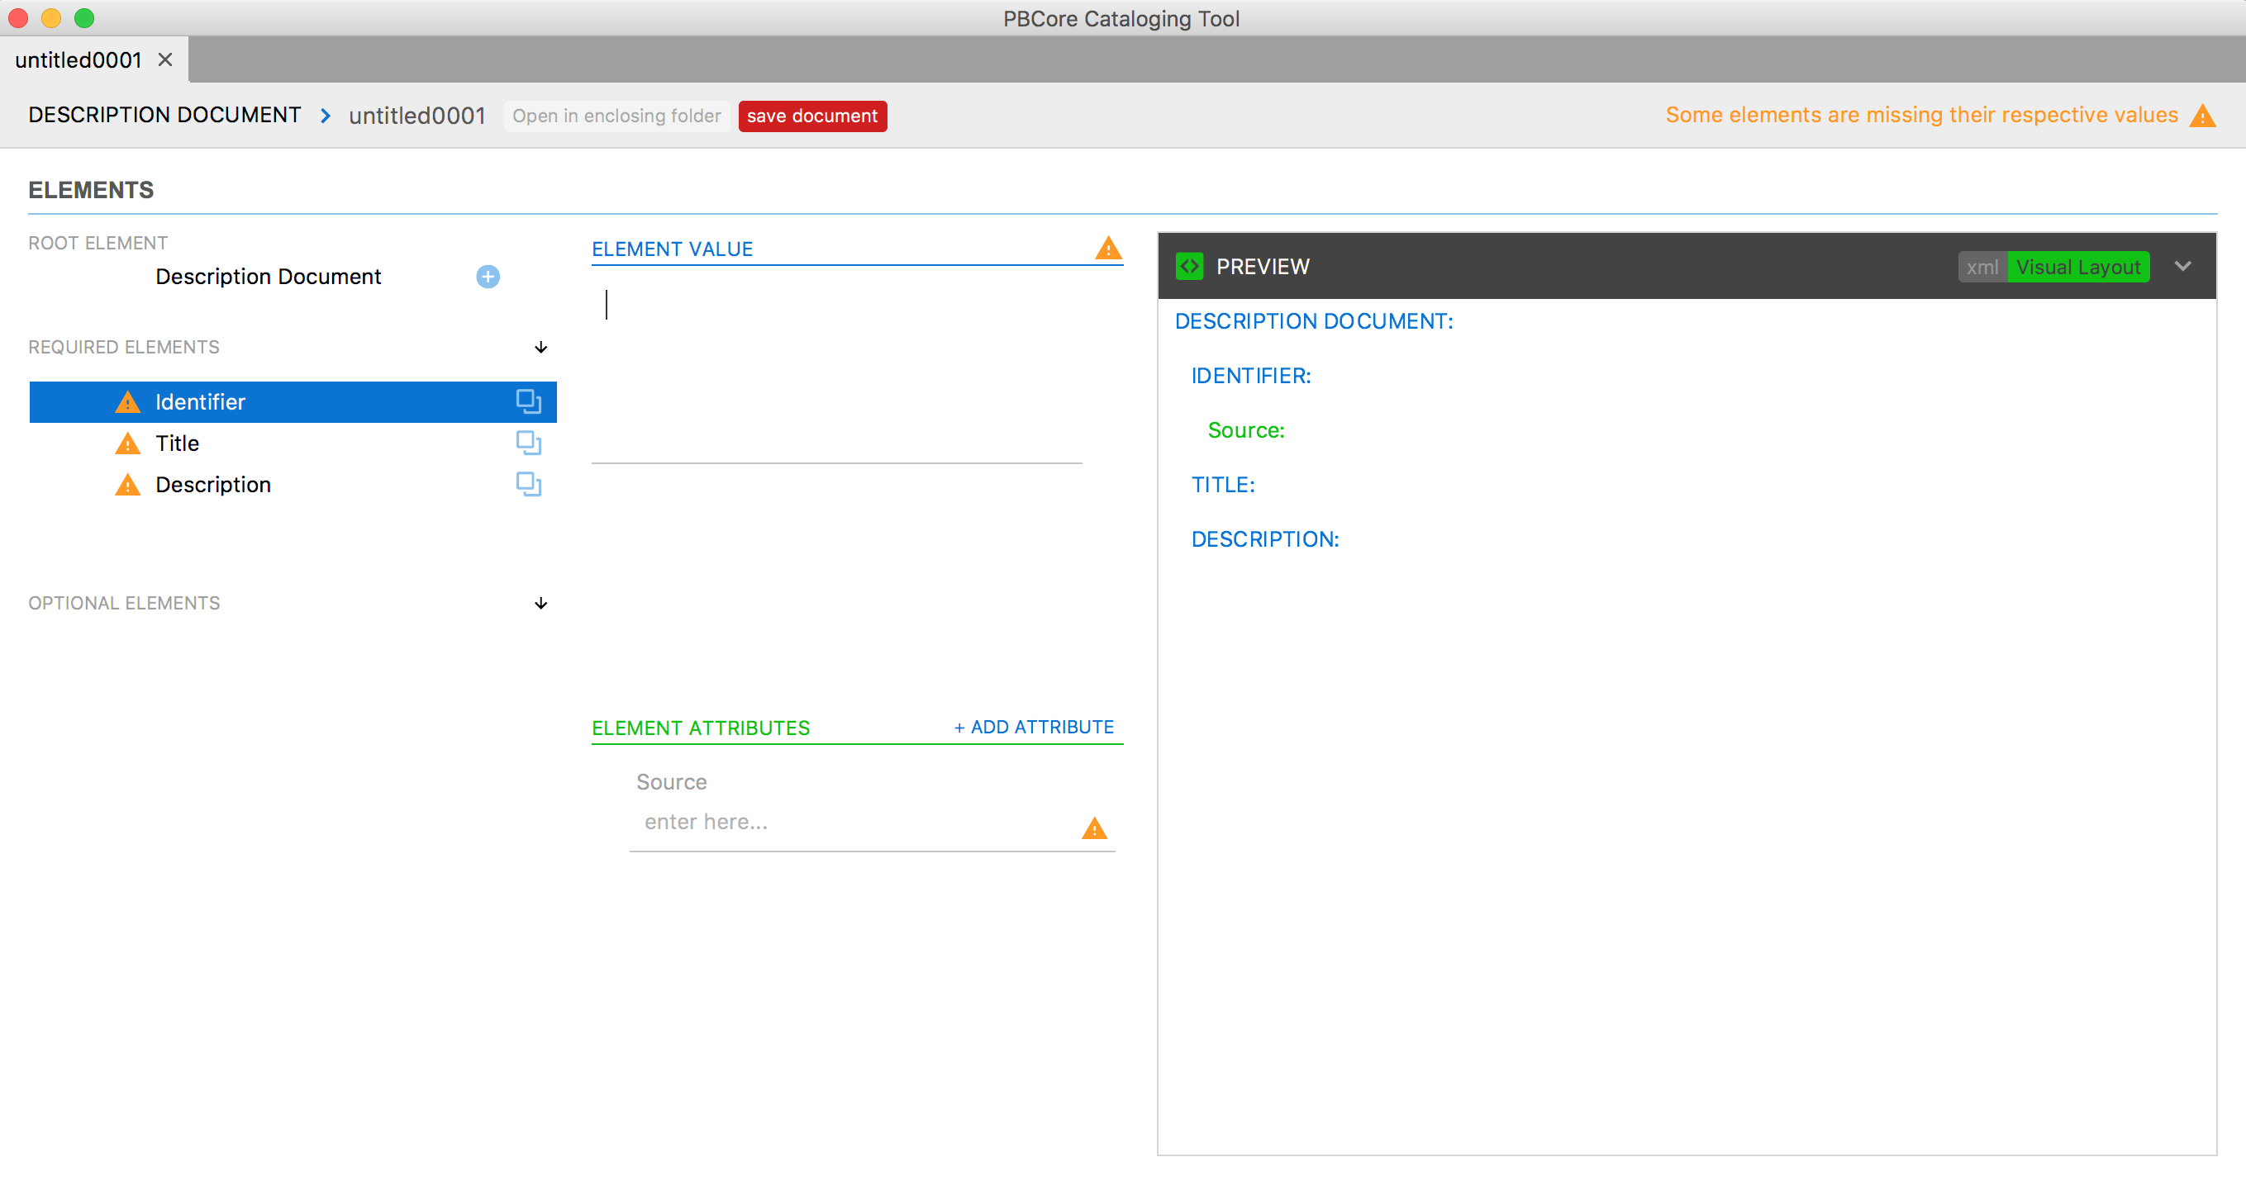
Create an Asset

Slide 7
Create an Instantiation

Slide 8
Create an Instantiation

Slide 9
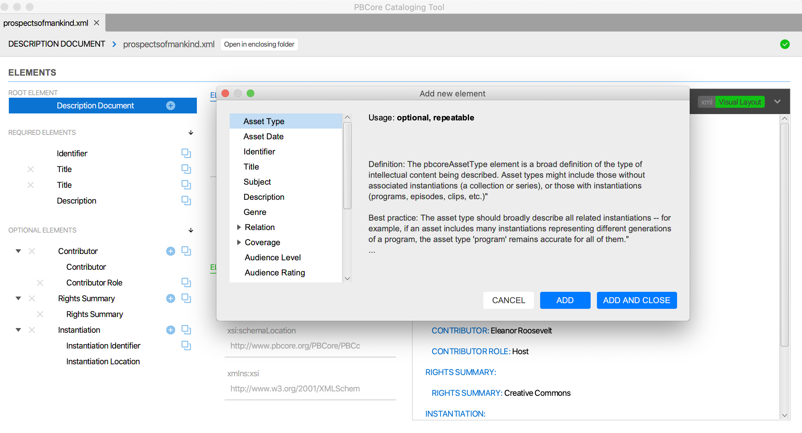
Add an Element

Slide 10
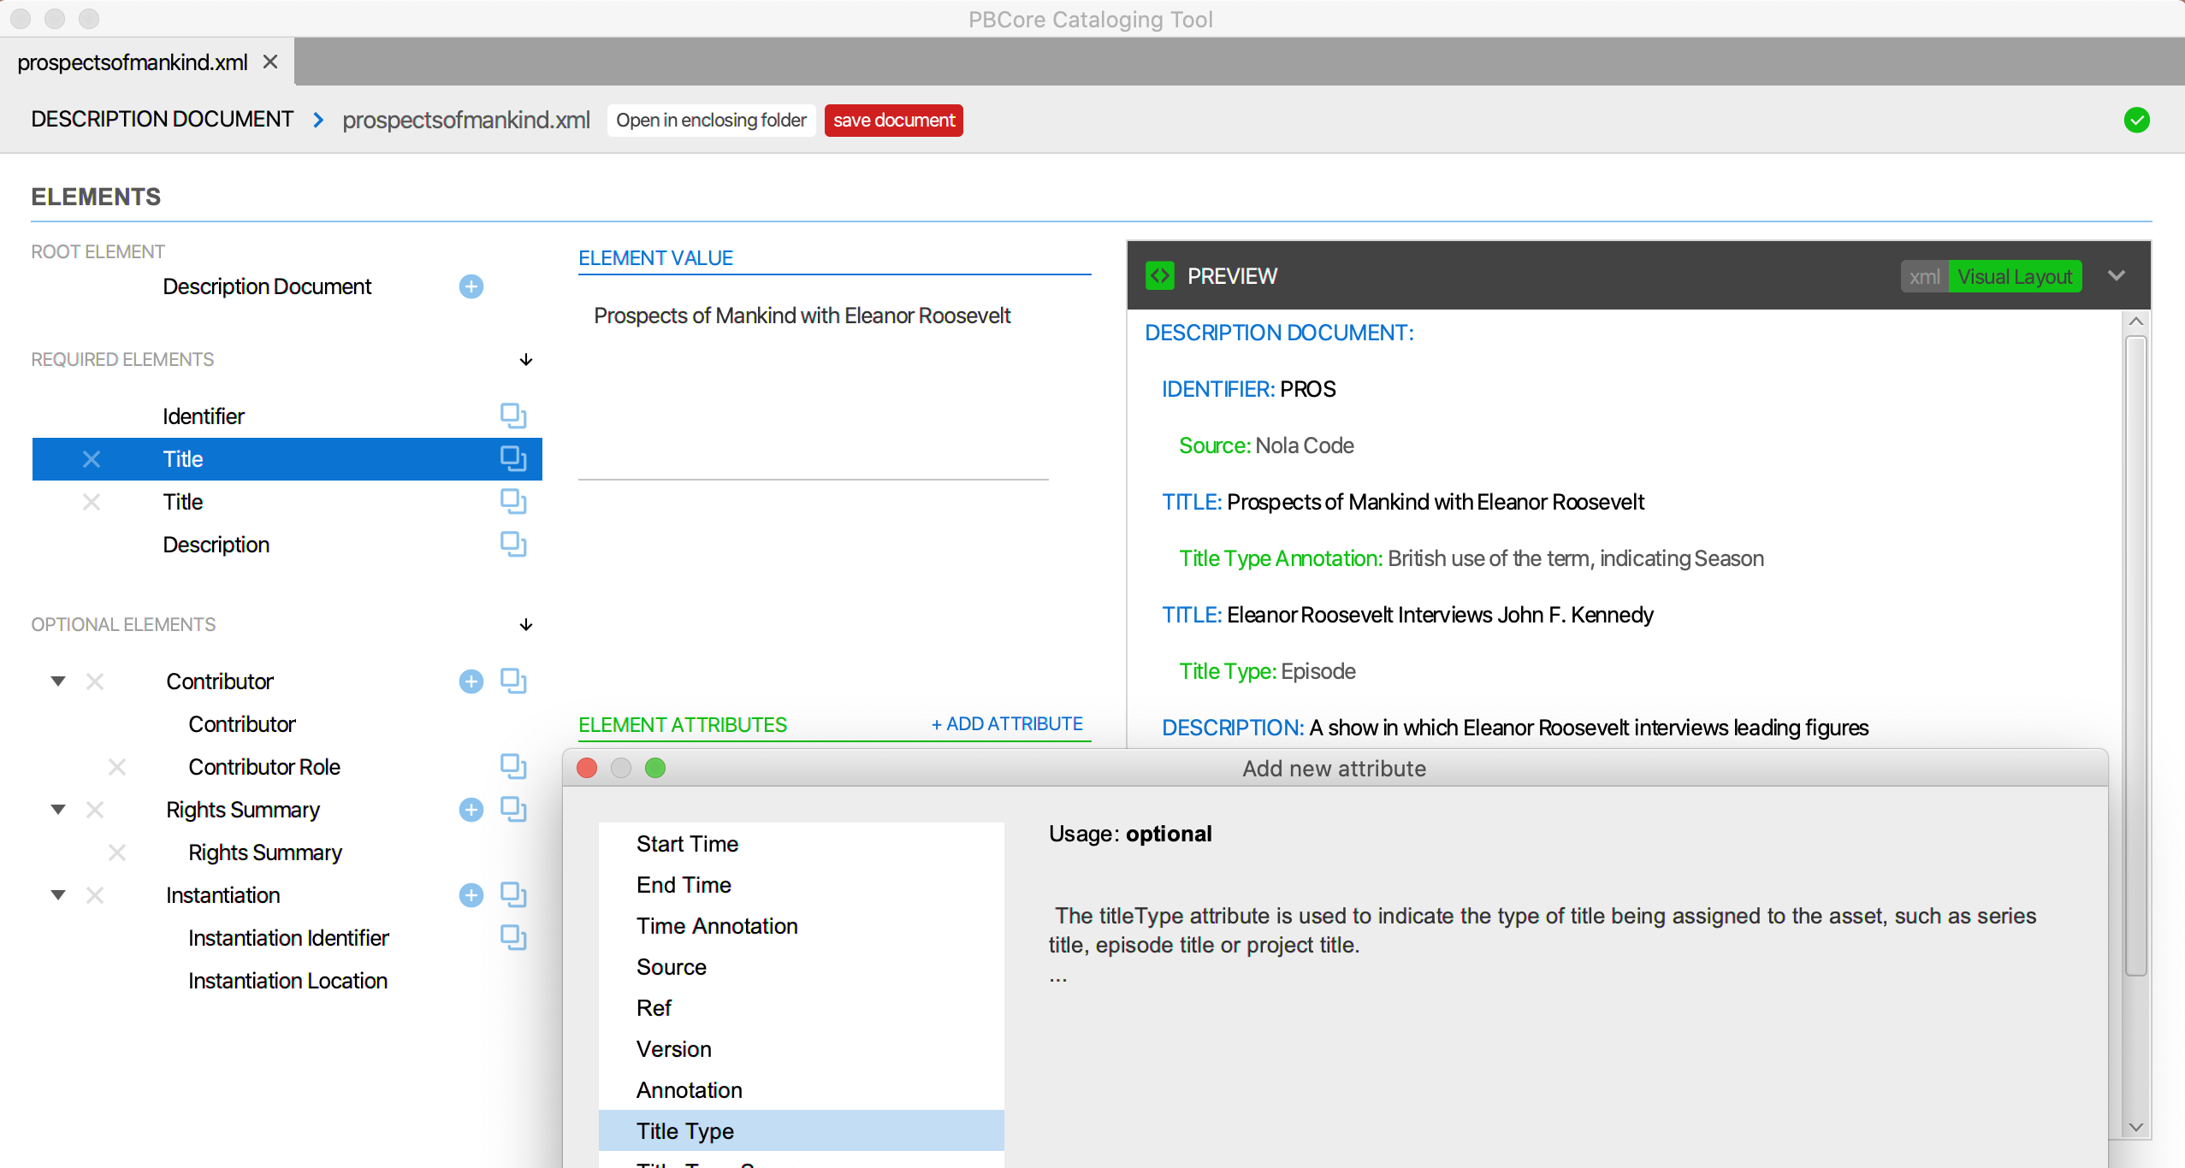
Add an Attribute

Slide 11
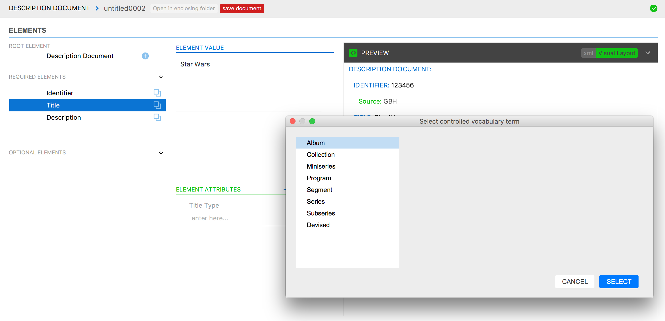
Use Controlled Vocabs

Slide 12
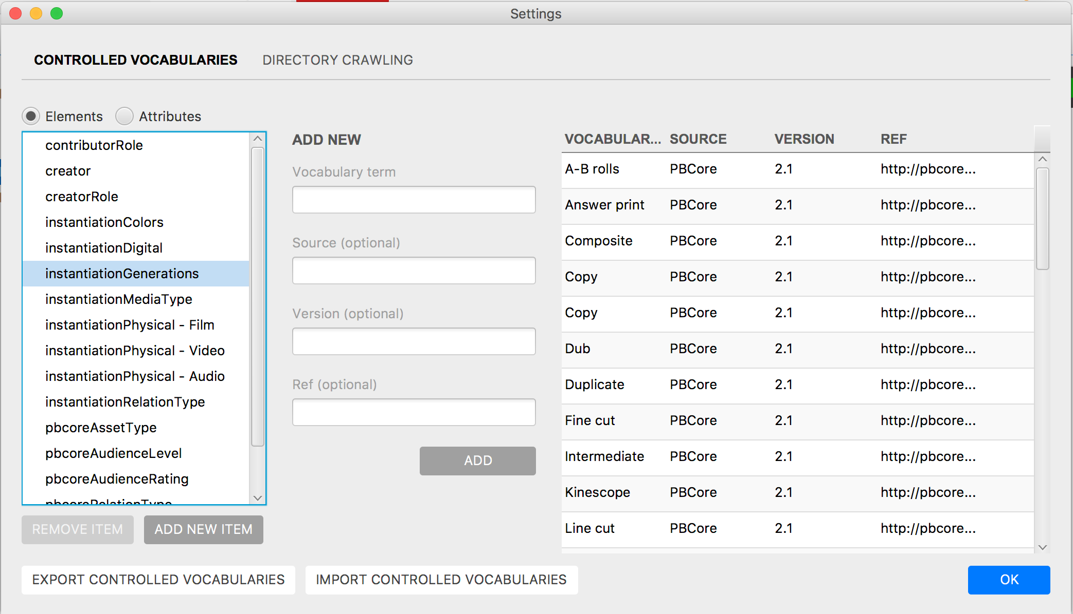
Use Controlled Vocabs

Slide 13
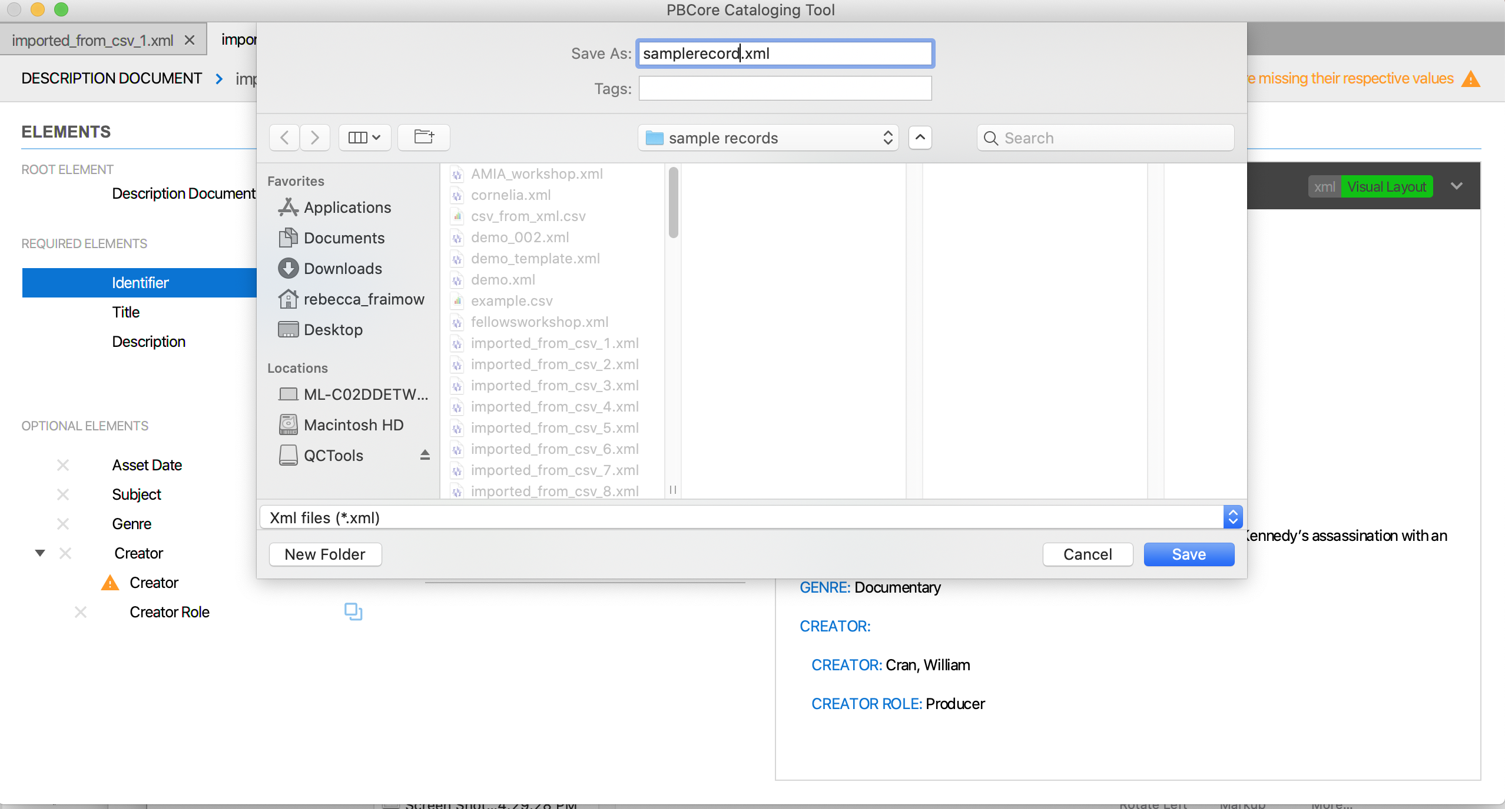
Save Records

Slide 14
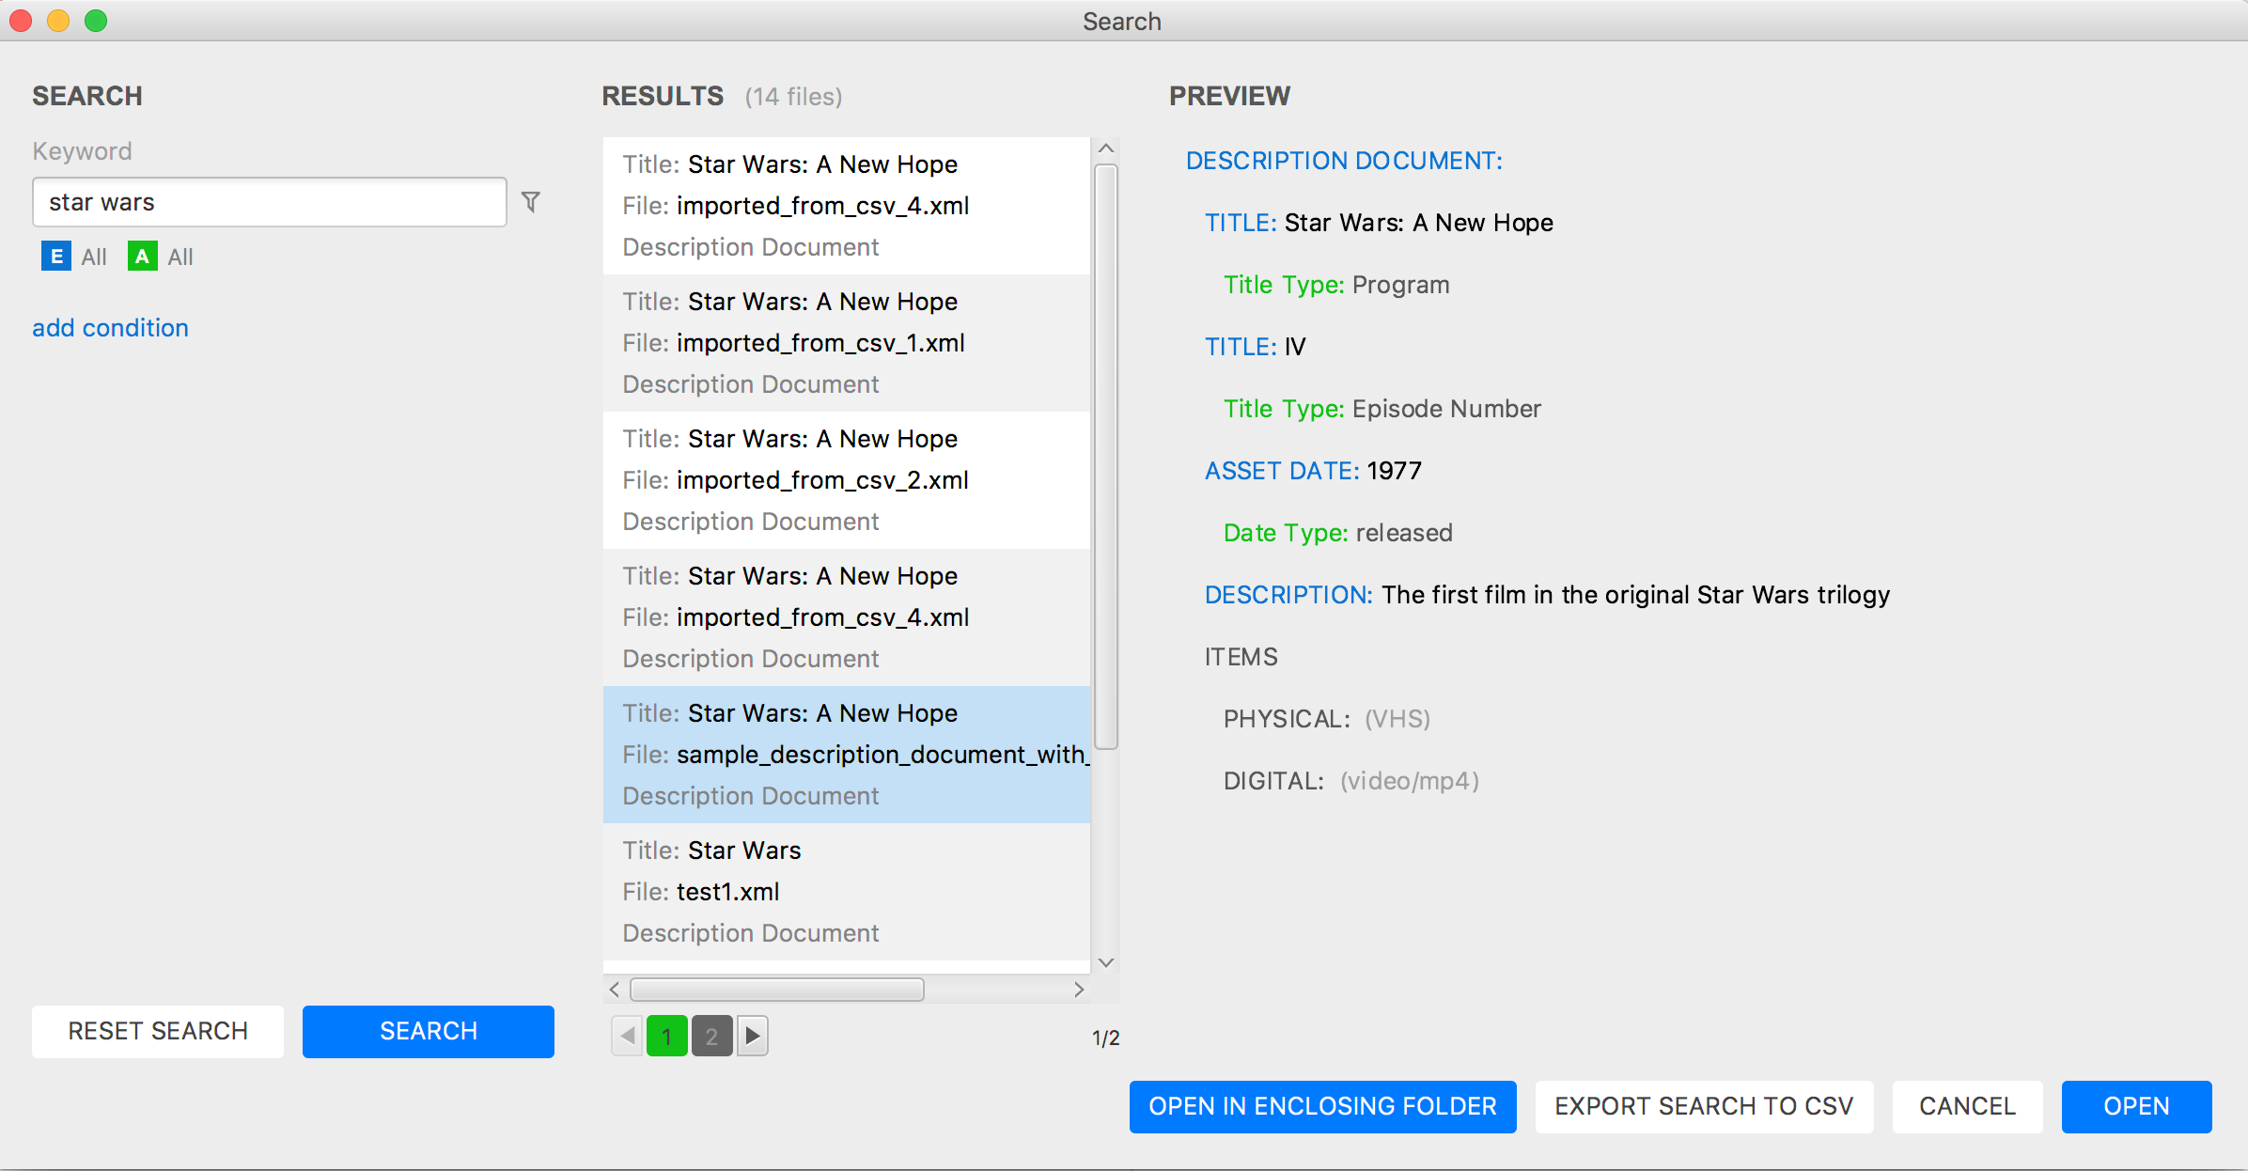
Search for Records

Slide 15
Use Advanced Search

Slide 16
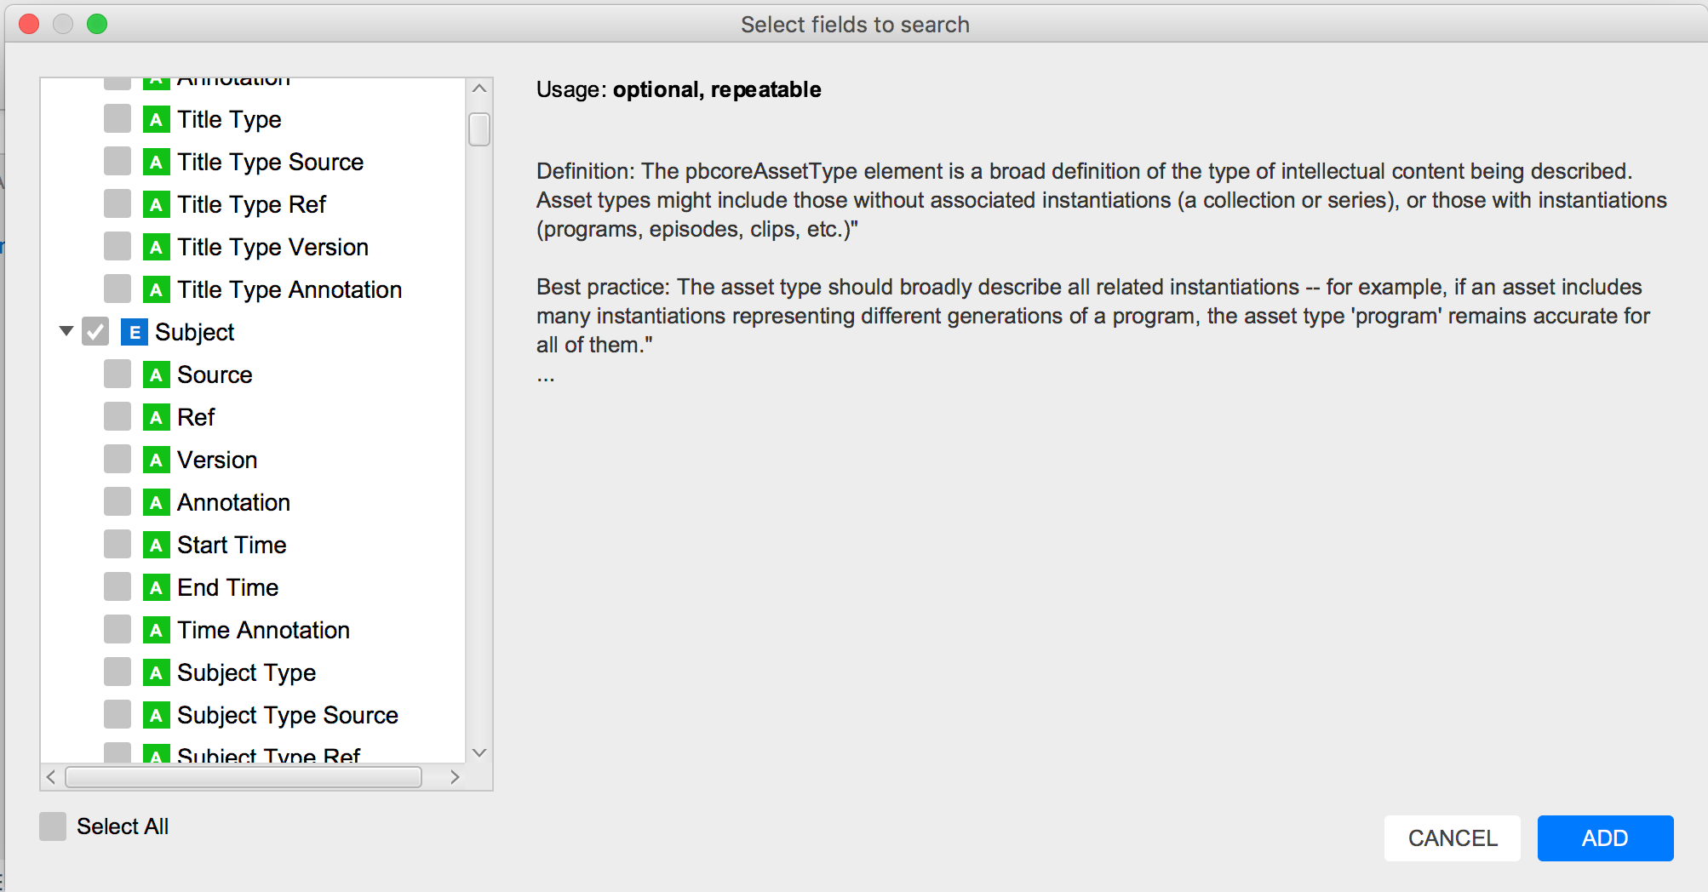
Use Advanced Search

Slide 17
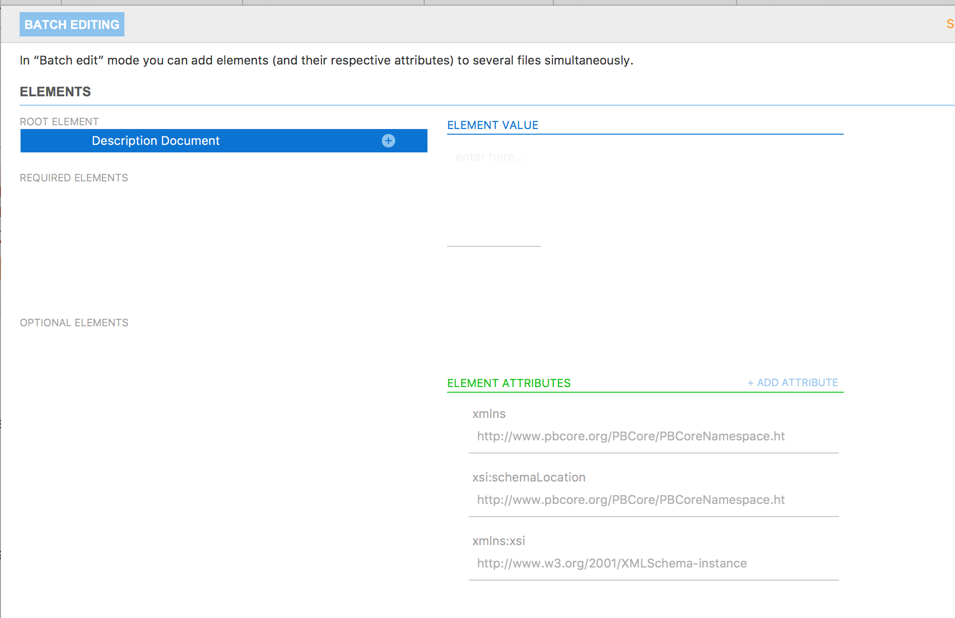
Batch Edit Records

Slide 18
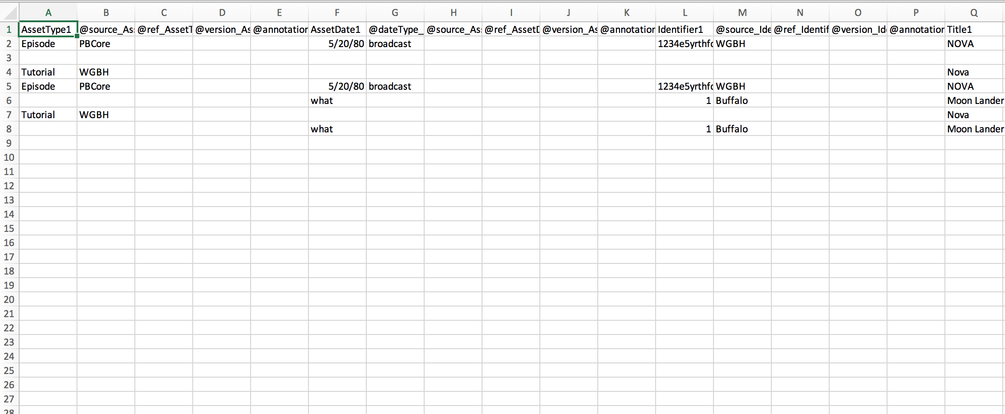
Create a Spreadsheet

Slide 19
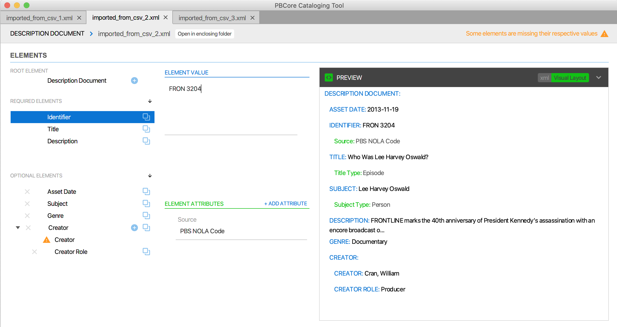
Open from Spreadsheet

Slide 20
Exercise
Each group has a case study that includes about a piece of media that exists in at least two different formats.
Using the PBCore tool, take ten minutes to create a record for your media in PBCore, including instantiation records for both formats.
In your breakout groups, compare your PBCore records. Do they look the same? How are they different? What did you find challenging about using the tool?

Slide 21
rebecca_fraimow@wgbh.org
Questions?

